Slide 1
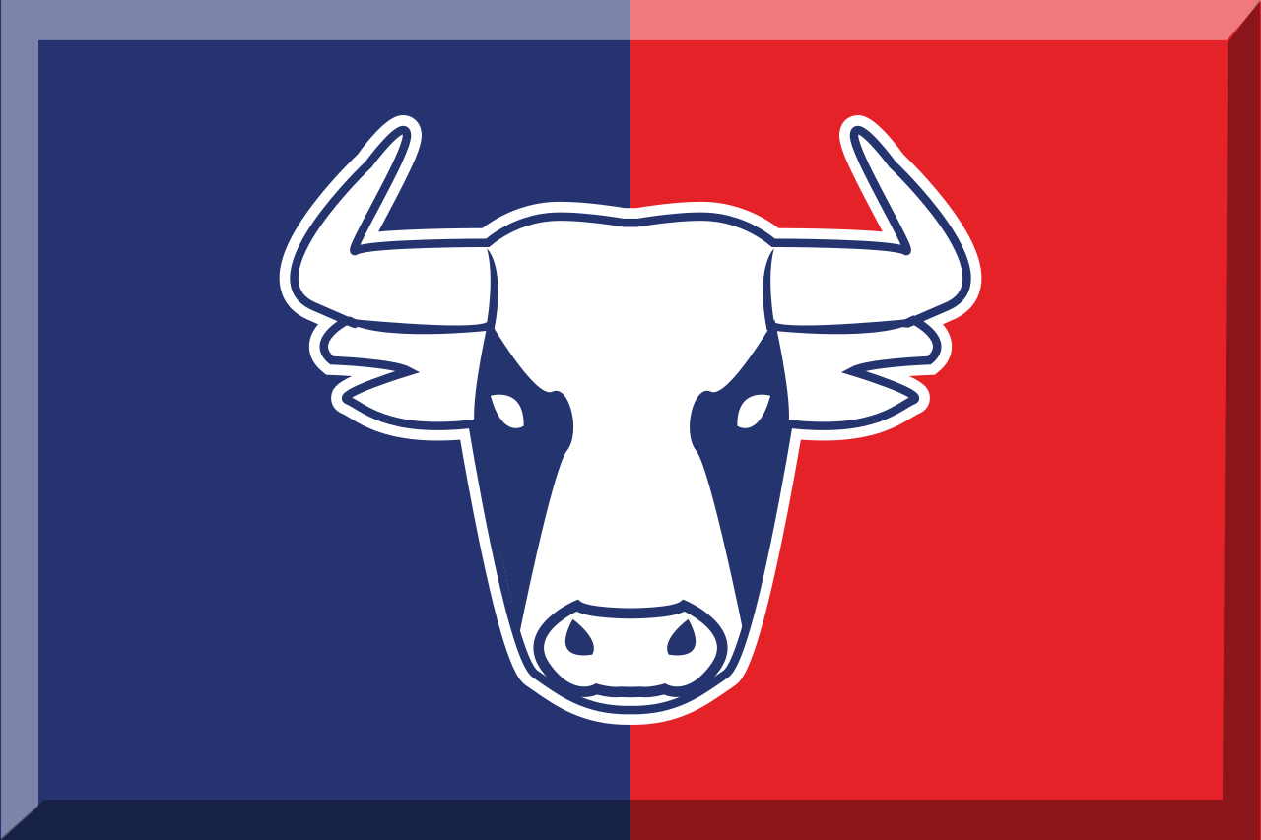
Data Analysis: Red Bull Account Sales

Slide 2
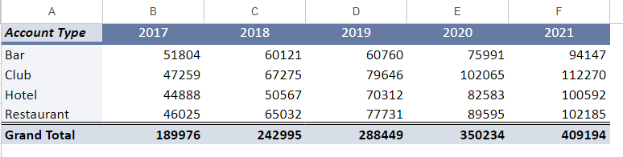
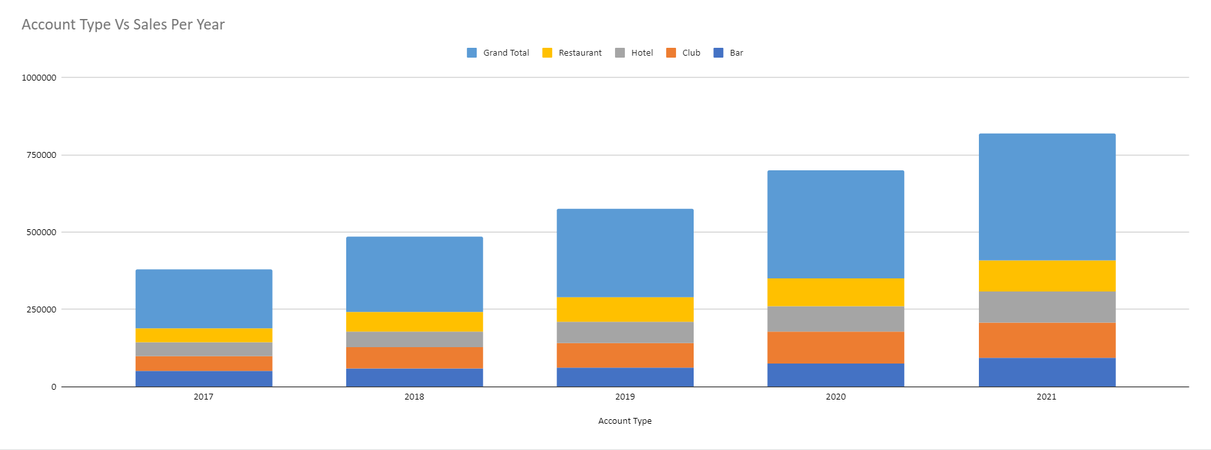
Total sales by account type and year

Slide 3
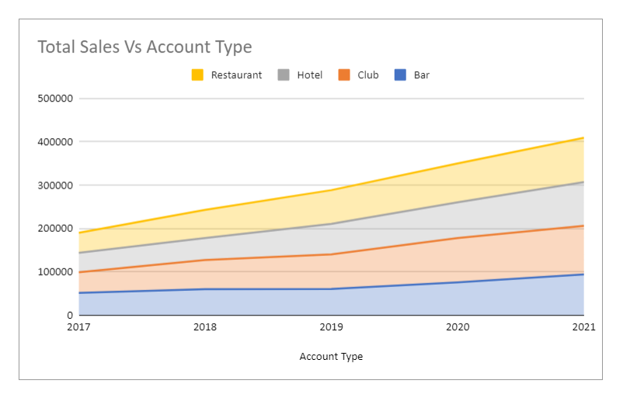
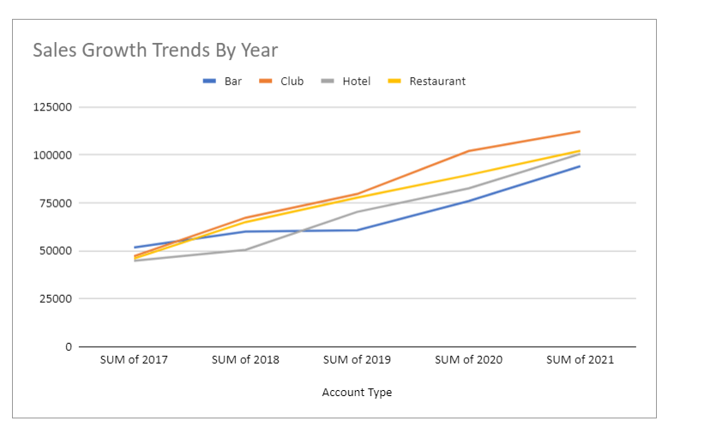

Slide 4
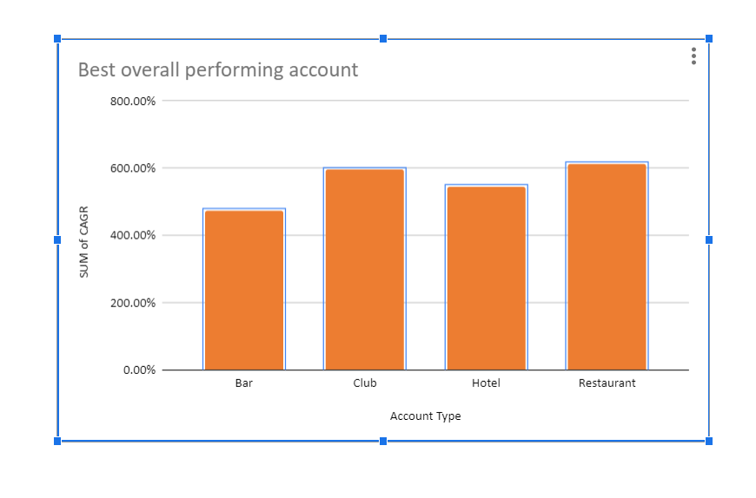
Best Overall Performing accounts

Slide 5
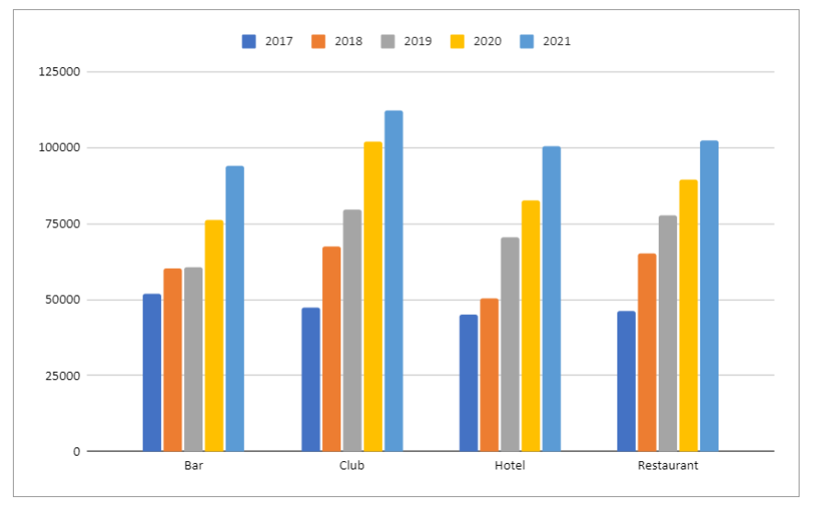
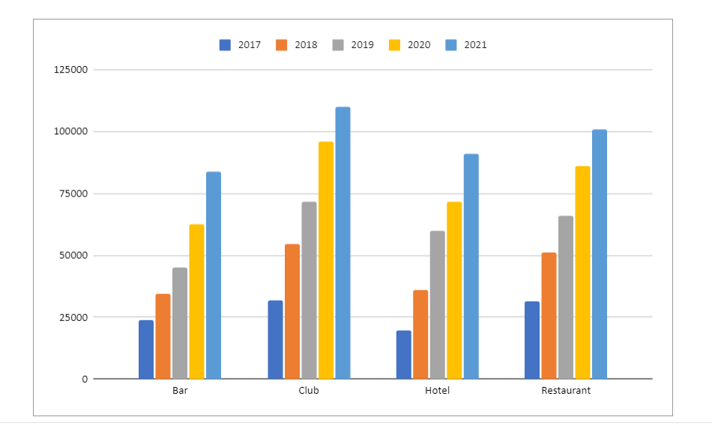
Different Product Sales over the years
REGULAR RED BULL- The best selling and the sales have increased gradually
SUGAR FREE- The second best selling and increasing in demand over the years still less compared to regular red bull.

Slide 6
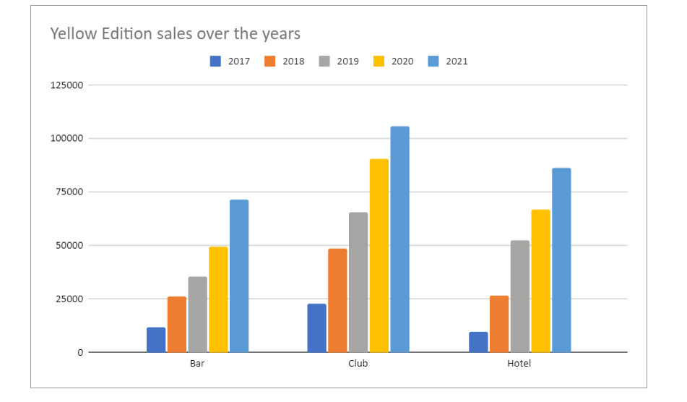
YELLOW EDITION- Not a regular one but a limited edition stayed in the market due to demand still one of the best sellers but not as much as regular. Sales have decreased over the years but still very good.

Slide 7
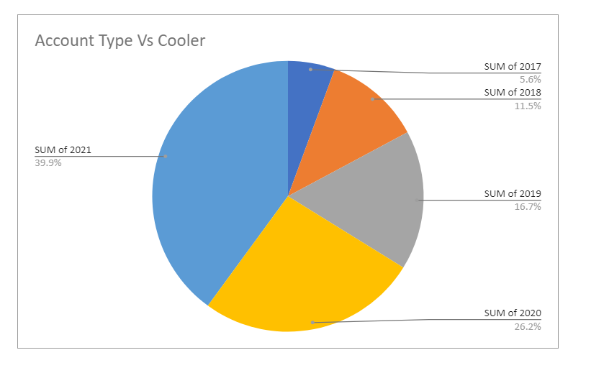
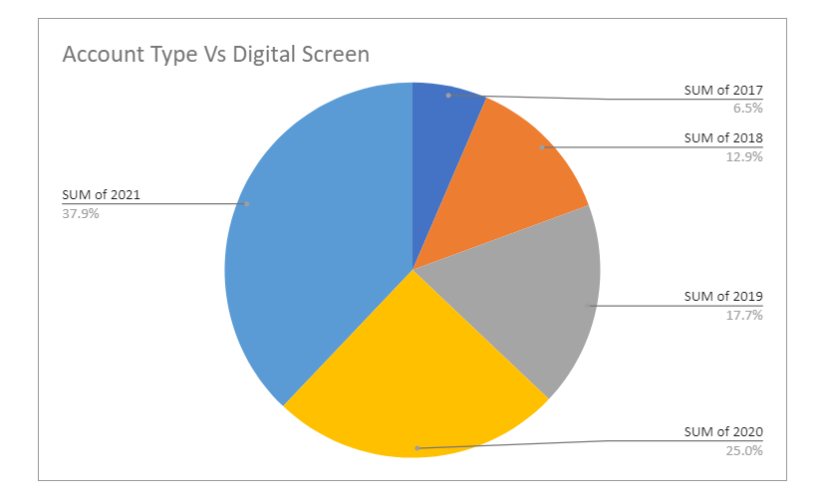
Account Type And Marketed Method over the years.

Slide 8
Observations and Key Takeaways
2021 was the best selling year for all the products combined.
Club is where all the products sells the best
Restaurant is the second best place where all the products sell the best
Menu inclusion is the best method of marketing considering the data trends
Regular product line is the best selling
Yellow edition now depleting so suggestion to revamp yellow edition to something more effective
bar is the place where the products sells the least so need to make a less caffeinated version of the product for that particular target audience
Club can be targeted more as there is still a lot of promise there.
Bar has a lot of improvement to be done as people prefer light drinks so we can introduce a product that has low caffeine and less energy and more sweet so can be used as a supplement for soda to make cocktails.

